Slide 1
OVERVIEW AND HISTORY OF ENGINEERING

Slide 2
What is Engineering?
Engineering, the application of science to the optimum conversion of the resources of nature to the uses of humankind.
The field has been defined by the Engineers Council for Professional Development, in the United States, as the creative application of “scientific principles to design or develop structures, machines, apparatus, or manufacturing processes, or works utilizing them singly or in combination; or to construct or operate the same with full cognizance of their design; or to forecast their behaviour under specific operating conditions; all as respects an intended function, economics of operation and safety to life and property.”
The words engine and ingenious are derived from the same Latin root, ingenerare, which means “to create.”
The concept of engineering has existed since ancient times as humans devised fundamental inventions such as the pulley, lever, and wheel. Each of these inventions is consistent with the modern definition of engineering, exploiting basic mechanical principles to develop useful tools and objects

Slide 3

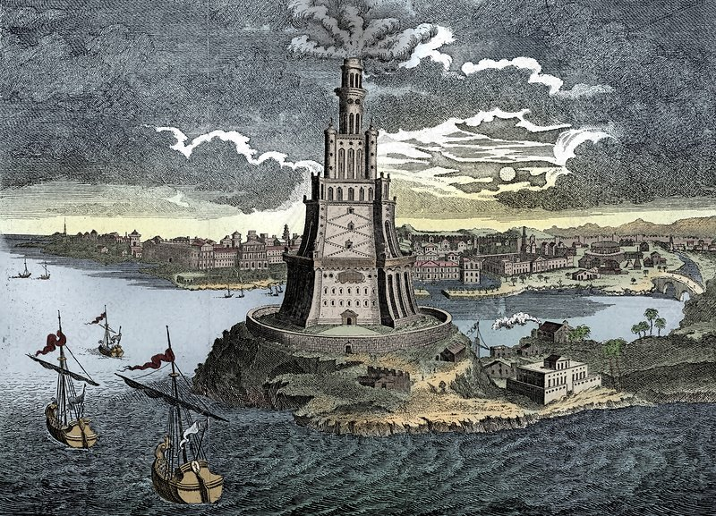
History of Engineering…
The first engineer known by name and achievement is Imhotep, builder of the Step Pyramid at Ṣaqqārah, Egypt, probably about 2550 BCE.
Imhotep’s successors—Egyptian, Persian, Greek, and Roman—carried civil engineering to remarkable heights on the basis of empirical methods aided by arithmetic, geometry, and a smattering of physical science.
The Pharos (lighthouse) of Alexandria, Solomon’s Temple in Jerusalem, the Colosseum in Rome, the Persian and Roman road systems, the Pont du Gard aqueduct in France, and many other large structures, some of which endure to this day, testify to their skill, imagination, and daring.
In construction, medieval European engineers carried technique, in the form of the Gothic arch and flying buttress, to a height unknown to the Romans. The sketchbook of the 13th-century French engineer Villard de Honnecourt reveals a wide knowledge of mathematics, geometry, natural and physical science, and draftsmanship.

Slide 4
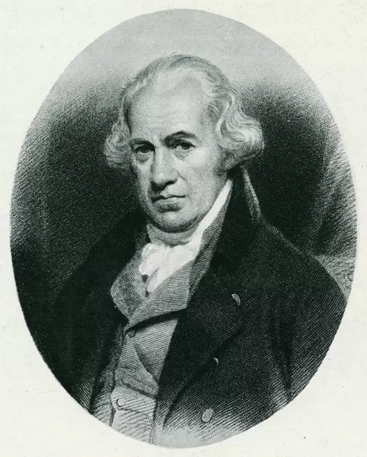
History of Engineering…
Civil enigineering emerged as a separate discipline in the 18th century, when the first professional societies and schools of engineering were founded.
Civil engineers of the 19th century built structures of all kinds, designed water-supply and sanitation systems, laid out railroad and highway networks, and planned cities.
England and Scotland were the birthplace of mechanical engineering, as a derivation of the inventions of the Scottish engineer James Watt and the textile machinists of the Industrial Revolution.
The development of the British machine-tool industry gave tremendous impetus to the study of mechanical engineering both in Britain and abroad.

Slide 5

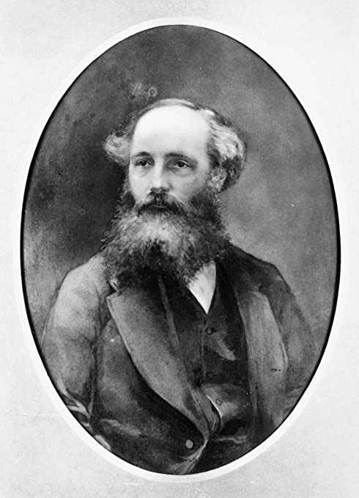
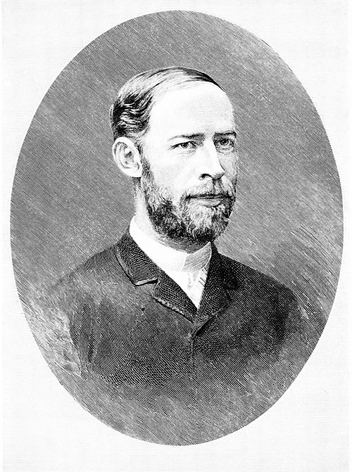
History of Engineering…
The growth of knowledge of electricity—from Alessandro Volta’s original electric cell of 1800 through the experiments of Michael Faraday and others, culminating in 1872 in the Gramme dynamo and electric motor—led to the development of electrical and electronics engineering.
The electronics aspect became prominent through the work of such scientists as James Clerk Maxwell of Britain and Heinrich Hertz of Germany in the late 19th century.
Major advances came with the development of the vacuum tube by Lee de Forest of the United States in the early 20th century and the invention of the transistor in the mid-20th century.
In the late 20th century electrical and electronics engineers outnumbered all others in the world.

Slide 6


History of Engineering…
Chemical engineering grew out of the 19th-century proliferation of industrial processes involving chemical reactions in metallurgy, food, textiles, and many other areas.
By 1880 the use of chemicals in manufacturing had created an industry whose function was the mass production of chemicals.
The design and operation of the plants of this industry became a function of the chemical engineer.
In the late 20th and early 21st centuries the field of environmental engineering expanded to address global warming and sustainability. The development and deployment of renewable energy, such as solar and wind power, the creation of new technologies for carbon sequestration and pollution control, and the design of green architecture and environmentally friendly urban planning are all recent developments.

Slide 7
THANK YOU
G R NITIN
CB.EN.U4CYS21017

